Slide 1
Chapter 11: Other evidence of evolution

Slide 2
11.1 Fossils
A fossil is any preserved trace left by an organism that lived long ago. Some fossils are bones, shells or teeth. However, fossils do not have to be a part of an organism; they also include footprints, burrows, faeces, or impressions of all or part of an animal or a plant. In the case of human ancestors, fossil remains are usually bones, teeth or sometimes footprints.
Fossil remains are extremely important as they allow scientists to determine exactly what extinct species were like. Other material associated with the bones, such as the rock in which they were found and fossils of other plants and animals, allows the scientist to develop a picture of life in the past.
There are many cases where the fossil record has allowed scientists to build up a sequence of the evolution of a particular plant or animal. One of the best known is the evolution of the horse, which can be traced through fossil remains from a small creature not much bigger than a small dog to the horses that we know today.

Slide 3
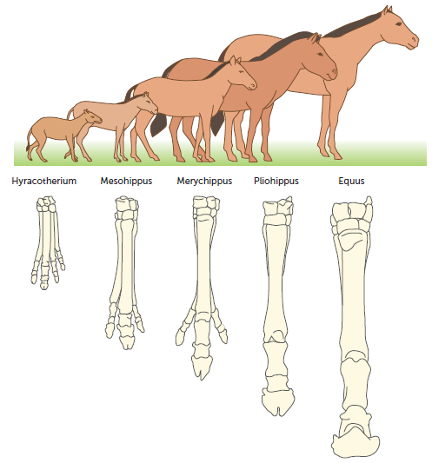
11.1 Fossils
The evolution of the horse, showing how the leg bones appear to have changed as the animal increased in size

Slide 4
11.1 Fossils
Fossil formation
When we consider the billions of organisms that have lived on Earth, the chance that a plant or animal will be fossilised is very small. Normally, dead organisms are decayed by micro-organisms and no trace of their existence is left. Parts of organisms may become fossilised when buried by drifting sand, mud deposited by rivers, volcanic ash or, in the case of some of the more recent human ancestors, other members of the species. If buried rapidly, conditions may not be suitable for the activity of decay organisms (decomposers), and decomposition may be slowed or prevented.

Slide 5
11.1 Fossils
Effect of soil type of fossilisation
The nature of the soil is very important for the fossilisation of bone. In wet, acidic soils the minerals in the bone are dissolved and no fossilisation occurs. However, if such soil contains no oxygen, as in the case of peat, complete preservation of the soft tissues and bones of the animal may occur. Bones buried in alkaline soils produce the best fossils because the minerals in the bones are not dissolved. New minerals, often lime or iron oxide, are deposited in the pores of the bone, replacing the organic matter that makes up about 35% by weight of the bone. The bone becomes petrified (turned into rock), but the details of structure are still preserved.

Slide 6
11.1 Fossils
Location of fossils
Fossils of human ancestors are often found at the edges of ancient lakes and river systems, in caves or in volcanically active areas. This is because the organism can be buried rapidly, preventing decomposition. Lakes and rivers build up sediments when flooding occurs or when the water flow slows rapidly. Many caves are in limestone, which consists of calcium carbonate. This chemical may be deposited around dead organisms, or the cave roof or walls may collapse, covering the bodies of animals. It is unusual for animals to be preserved near volcanic eruptions because heat from the volcanic material destroys the organism, but in East Africa ash falls have preserved fossils of many human ancestors.

Slide 7
11.1 Fossils
Discovery of fossils
The discovery of fossils is usually the result of slow and painstaking excavation of likely sites using small hand tools. Surface discoveries such as fossil fragments, or evidence of human occupation such as that found in many caves, are indications of places where excavations may prove fruitful. Scientists refer to an excavation as a ‘dig’.
In the case of fossils of human ancestors, artefacts are often found in association with the fossils. Artefacts are objects that have been deliberately made by humans. They include items such as stone tools, beads, carvings, charcoal from cooking fires, and cave paintings.
Photographs are taken at every stage of a dig so that detailed studies of the positions of uncovered material can be carried out later. Each item is carefully labelled and catalogued for the prolonged study that follows the excavation of the site. In the laboratory, fossil bones are carefully scraped clean, broken parts are pieced together, measurements are taken, and plaster casts or latex moulds may be made.

Slide 8
11.2 Dating fossils
One of the major tasks following the excavation of fossils or artefacts is to determine the age of the material, known as dating. Knowledge of the age is crucial in finding out the sequence of changes that have resulted in present-day humans. Various methods of dating fossils and material associated with human ancestors have been devised. Dating can provide:
absolute dates – the actual age of the specimen in years
relative dates – a comparison of fossils to tell us whether one sample is older or younger than another.
Modern technology has enabled accurate estimates to be made of the absolute age of many samples. However, when that is not possible, knowing whether one fossil is older or younger than another is very important.
The age (or date) of a fossil or artefact is usually given in years before the present time. For example, a fossil may be said to date from 45 000 years BP (before present), which is another way of saying it is 45 000 years old.

Slide 9
11.2 Dating fossils
Absolute dating
Potassium argon dating
Potassium is one of the most abundant elements in Earth’s crust, and is therefore found in some rocks. The potassium–argon dating technique is based on the decay of radioactive potassium to form calcium and argon. Potassium (chemical symbol K) is a mixture of three different isotopes.
Isotopes are atoms of the same element with different numbers of neutrons. Isotopes of potassium all have 19 protons, but atoms of potassium-39 have 20 neutrons, atoms of potassium-40 have 21 neutrons, and atoms of potassium-41 have 22 neutrons. Potassium-40 is a radioactive isotope and decays to form calcium-40 and argon-40. Such decay takes place at an extremely slow, but constant rate, and so determining the amounts of potassium-40 and argon-40 in a rock sample enables the age of the rock to be calculated. As the rock ages, the proportion of potassium-40 decreases while that of argon-40 increases.

Slide 10
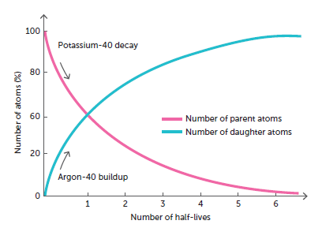
11.2 Dating fossils

Slide 11
11.2 Dating fossils
Potassium–argon dating has limited usefulness: not all rock types are suitable for this method of dating and it can only date rocks older than 100 000 to 200 000 years. The half-life of potassium-40 is 1250 billion years (1.25 x 10⁹ years). This means that it takes 1250 billion years for half of the potassium-40 to decay. Therefore, after 100 000 years, only 0.0053% of the potassium-40 in a rock would have decayed to argon-40. Such a small amount pushes the limits of detection devices currently in use. Therefore, potassium–argon dating is most useful on samples that are older than 200 000 years.
To determine the age of a fossil using this method, some suitable rock of the same age as the fossil must be available. The age of the rock is determined using potassium–argon dating, and hence the age of the fossil is inferred. This situation can occur when rocks produced in volcanic eruptions bury bones.

Slide 12
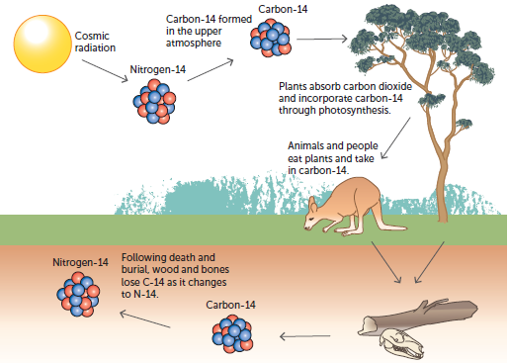
11.2 Dating fossils
Carbon-14 dating
The carbon-14 or radiocarbon dating method is based on the decay of the radioactive isotope of carbon, carbon-14, to nitrogen. Carbon-14 is produced in the upper atmosphere by the action of cosmic radiation on nitrogen at about the same rate at which it decays. In the atmosphere there is a ratio of one carbon-14 atom to every million million (10¹²) atoms of the stable isotope carbon-12.

Slide 13
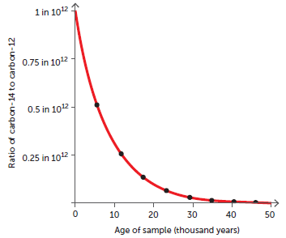
11.2 Dating fossils
When green plants use atmospheric carbon dioxide in photosynthesis, one atom in every million million of the carbon atoms incorporated in the plant tissues is carbon-14. Should an animal eat the plant, the carbon-14 then becomes a part of the animal’s tissues. With death, an organism’s intake of carbon-14 ceases, but the carbon-14 already in the tissues of the organism continues to decay at a fixed rate. By measuring the amount of radiation liberated by a sample, the ratio of carbon-14 to carbon-12 can be estimated, and from this the age of the sample can be calculated. The graph shows the rate of decay of carbon-14.

Slide 14
11.2 Dating fossils
The normal method of radiocarbon dating requires at least three grams of organic material so that the rate of radioactive decay of carbon-14 in the sample can be measured. A more refined technique, known as accelerator mass spectrometry (AMS) radiocarbon dating, can be used to date a sample as small as 100 micrograms (0.0001 grams).
After about 70 000 years, the percentage of carbon-14 left is only 0.021%. This is too small to be able to measure accurately; therefore, radiocarbon dating method cannot be used to date back more than about 60 000 years. A further limitation is that the material to be dated must contain organic compounds, compounds from living things that contain carbon. Radiocarbon dating is nevertheless of great value in dating fossils of more recent origin and also in dating artefacts.
Another problem is that it is now known that the amount of carbon-14 in the atmosphere varies. Therefore, radiocarbon dates must be treated with a certain degree of caution.

Slide 15
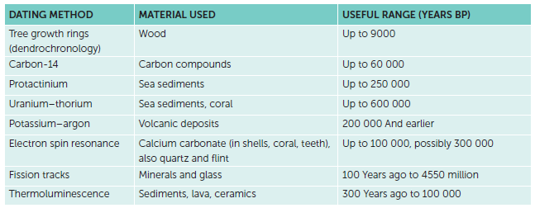
11.2 Dating fossils
The table shows the approximate time span applicable to these methods and also those of some more recently developed techniques.

Slide 16
11.2 Dating fossils
Relative dating
Stratigraphy
Stratigraphy is the study of layers, or strata. There are two ways in which stratigraphy can be useful in dating fossil material. The first is the principle of superposition, which assumes that in layers of sedimentary rock the layers at the top are younger than those beneath them. Thus, any fossils or other material found in the top layers will be younger than material found lower down. This principle must be applied with care because distortions of Earth’s crust do occur, and a sequence of rock layers may be turned upside down. In addition, it is possible for fossils or artefacts to be buried by animals, or perhaps by early humans, some time after the deposition of sediment. In this case, the specimen may be younger than some of the layers above it.
The second use of stratigraphy is in the correlation of rock strata, which involves matching layers of rock from different areas. Matching of strata can be done by examining the rock itself, and also by studying the fossils it contains. Rocks that contain the same fossils may be assumed to be of the same age. Index fossils are of great value in this correlation work because they are widely distributed and were present on Earth for only a limited period of time.

Slide 17
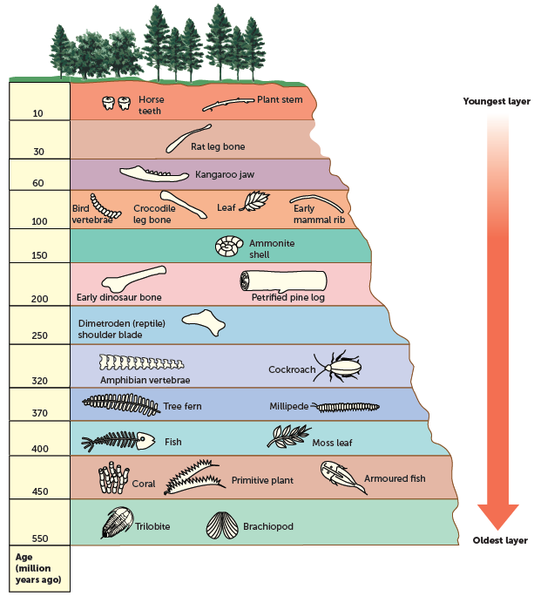
11.2 Dating fossils
This diagram shows how index fossils may be used to correlate strata from different localities, often hundreds, or even thousands, of kilometres apart.
The principle of superposition assumes that the younger strata are towards the top of the sequence.

Slide 18
11.2 Dating fossils
Problems with the fossil record
The fossil record is very incomplete as conditions for fossilisation do not always occur, or occur at irregular periods of time. For fossils to be formed, four conditions are usually required:
• a quick burial of the material
• the presence of hard body parts
• an absence of decay organisms
• a long period of stability – the organism needs to be left undisturbed.
Fossilisation is therefore a chance occurrence and there are many gaps in the fossil record because organisms have not been preserved.
There are also gaps because most fossils that do exist haven’t been discovered (buried too deep, inaccessible or inadvertently destroyed), or ones that have been found may not be possible to date.

Slide 19
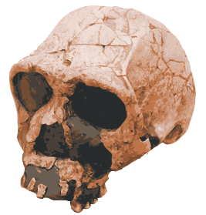
11.2 Dating fossils
It is unusual to find a fossil of an entire organism, or the whole skeleton of an organism. This is particularly true of fossils of human ancestors. Often, from just a few fragments of bone, scientists have to reconstruct what the organism may have looked like.
Such reconstructions are only approximations based on the experience of the scientists involved. Other scientists may disagree with the interpretation and this can lead to considerable controversy.
The reconstructed skull of Homo ergaster. Found in Kenya, the fragments were dated at around 1.8 million years old, and were pieced together like a jigsaw puzzle. Areas shown in black are parts of the skull where bones are missing.

Slide 20
11.3 Comparative anatomy
Embryology
Comparative embryology provides evidence for evolutionary change over time by comparing the early stages in the development of organisms. Although it is relatively easy to distinguish between the adults of different species, it is frequently far more difficult to tell the difference between embryos.
In vertebrates, comparing the embryonic stages reveals a remarkable similarity between different species at different times.
At one point in their development, the embryos of humans and chickens have slits and arches in their neck. These are similar to the gill slits and arches in fish, but do not develop into gills. However, their similarities indicate a common ancestor.
Additional features common to vertebrate embryos at one stage are the presence of a tail, a two-chambered heart and similar brain development. This all adds up to striking evidence for a common ancestry with later evolution along different pathways.

Slide 21
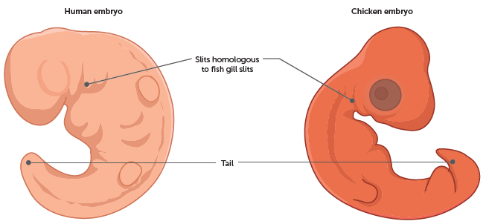
11.3 Comparative anatomy
Comparing the human and chicken embryo at one stage of development

Slide 22
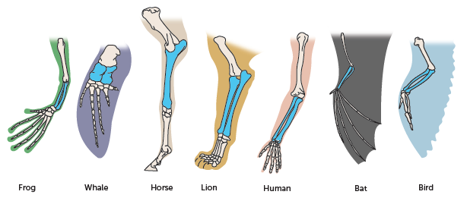
11.3 Comparative anatomy
Homologous structures
The forelimbs of vertebrates can be used to illustrate similarity in anatomy. The same bones appear in various forms throughout the vertebrates: the feet of amphibians and reptiles, the wings of bats and birds, the leg of a horse, the flipper of a whale or seal, and the human hand. The degree of similarity between the bones can be seen in the diagram. In every case the bones are arranged in a similar way, even though some have developed different functions. These forelimb bones are described as homologous structures because they possess a similar structure. Organisms possessing homologous structures are likely to have a common ancestor.

Slide 23
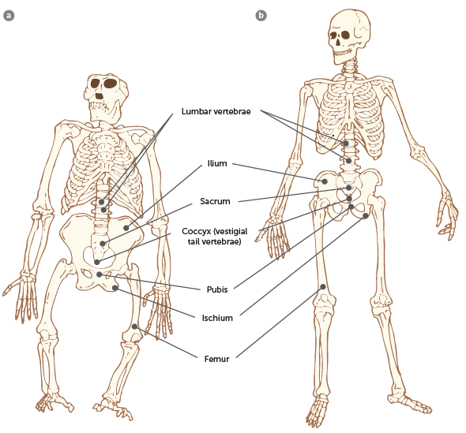
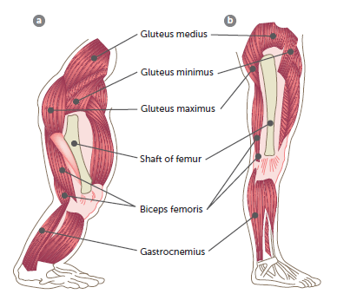
11.3 Comparative anatomy
Anthropoids, the human-like primates, show a great many anatomical resemblances. The diagrams show the skeletons of a gorilla and b human, and the arrangement of muscles in their legs. Note the high degree of similarity between them. These two species share a common ancestor and are therefore closely related.

Slide 24
11.3 Comparative anatomy
Vestigial structures
Vestigial structures are structures that have changed during evolution to the point that they no longer fulfil their origin function. They are common in vertebrate species. Vestigial structures are largely or entirely functionless when their original role is being considered. However, some may retain lesser functions or develop new ones. Humans may have as many as 90 of these structures. E.g.:
The nictitating membrane
The muscles that move the external ears of many mammals
The third molars, or wisdom teeth
The vertebrae for a tail, fused to form the coccyx
The muscles at the base of hairs
The appendix
They are what remain of organs that were functional in ancestral forms. Over time, and with changing environmental conditions, such organs were no longer essential to survival and were gradually reduced to vestigial remnants.

Slide 25
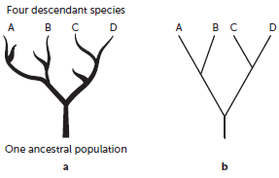
11.4 Phylogenetic trees
A phylogenetic tree, also called a dendrogram, represents the evolutionary relationships between a number of organisms derived from a common ancestor. The ancestral organism forms the base of the tree, and those organisms that have arisen from it are placed on the ends of ‘branches’. Relationships between the various organisms are shown by the distance between them on the tree, with closely related groups positioned on ‘branches’ close to one another. However, keep in mind that these are only inferred relationships.
They are often used to simplify more complex relationships, in order to enable them to be more easily understood.
They are useful for organising knowledge of genetic diversity and structural classifications.
A simple phylogenetic tree representing one ancestral population and four descendant species

Slide 26
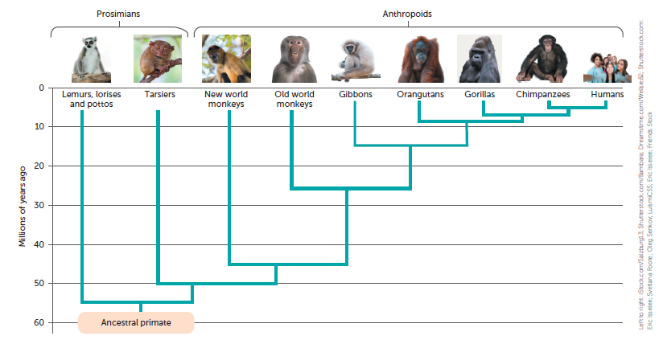
11.4 Phylogenetic trees
Left to right: iStock.com/Salzburg13; Shutterstock.com/Bambara; Dreamstime.com/Wellsie82; Shutterstock.com:
Eric Isselee; Svetlana Foote; Oleg Senkov; LuismiCSS; Eric Isselee; Friends Stock
A phylogenetic tree of primates

